Slide 1
Big Data Use Cases in Banking/Finance (Specific use of Big Data at a startup, Yabx, a FinTech undertaking)
By Hardik Raja
Batch: DP1904
Date: 14th March 2020

Slide 2
Big Data, New-age Fintech start-ups are revolutionising the Finance sector at a Global Level
In India : Big Data + Predictive Models + Aadhar
Assess financial risk in quicker, precise and more reliable
Current Delivery of financial products at touch of a Button
Study by Analytics India and AnalytixLabs -> Indian data analytics market to double by 2020 end; About 24 % being attributed to Bigdata.
Important use cases of Bigdata in Banking/Finance
Customer Churn Reduction
Big Data Helps Retain Valuable Banking Customers
Huge data over time
Social Media Posts
Fraud Detection
Increase in Fraud due to expansion in e-commerce
Finding anomalous patterns based on behaviour model

Slide 3
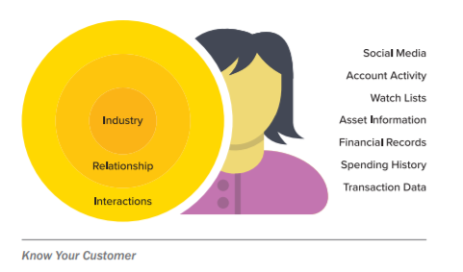
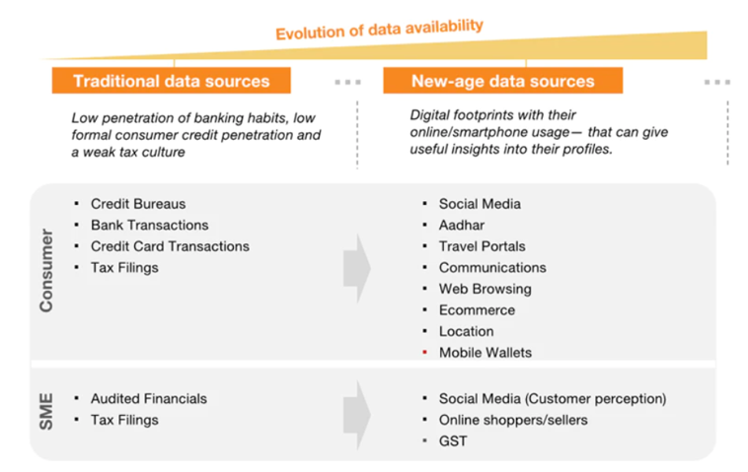
Build Strong Marketing Strategies
- Analyse likes/dislikes
- 360° view of their customers
Alternative lending
Personal Loans, Business Loans, Payday Loans, Student Loans, P2P Lending, Purchase Lending
Chqbook.com - Gurgaon based FinTech
India's First Market Place Bank for Small Business Owners (across SMEs, HoReCa and Kiranas)
Helping them through multiple segments; Lending, Credit Cards, Rewards.
Uses alternate data and work with credit bureaus, partners and financial institutions
Loanzen - Bengaluru based FinTech
Loanzen provides loans to purchasers of used commercial vehicles
SlicePay - Bengaluru based FinTech
Offers payment cards tailored to the needs of students and young professionals between age 18 to 29 years

Slide 4
Personalized Banking
Peta bytes of data every year
AI-powered Chatbots
Pitch Financial products as per need
Wealth Management
Apps offering personalized financial advice to help individuals achieve their financial goals.
Kuvera - Bengaluru based FinTech
India's first Direct-Plan, Mutual Fund investing platform.
AI powered Goal Planning & Fund Recommendation
Kristal.AI - Singapore based FinTech
1st ever Robo-advisory to bring personalized, AI-powered international investments to India in a seamless manner.
Access to curated portfolios from the world's top Portfolio Managers. Helps choose the best investment strategies to meet one’s financial goals.
Festive/Periodic Offers
Big data analysis to predict the offer period window to get maximum business

Slide 5
Risk Mitigation
Identify stressed accounts early on and improve recovery and profitability
Interlinks Bigdata with a layer of artificial intelligence to unlock hidden patterns
Bahwan CyberTek (BCT) – Chennai Based Global Technology Company
Drive digital transformation for financial institutions through their risk management product suite rt360
rt360 offers a comprehensive suite of risk management & regulatory compliance solutions for the banking industry, spanning across credit risk, liquidity risk, model risk, and operational risk

Slide 6
Case study at Yabx - A FinTech undertaking
Gurgoan based B2B start-up, founded by Rajat Dayal
Part of the Mahindra Group operating in the financial services space
Incubated in December 2017 within Comviva, a child company within Mahindra Group providing technology solution focused on the mobile operators and banks
Globally, only 5 % to 15 % of the population, gets bank credit;
Population including Consumers and SME’S
Mobile phone penetration is over 85 percent
People not getting credit;
Reason ??

Slide 7





Entities

Slide 8
Yabx model
Unmet Need - Limited or non-existent financial footprint
Alternate Data - Mobile phone generating significant data; Data Leveraged to create unique behavioral profiles
Financial Identity - Transform alternate data into financial identity (behavioral profiles) using ML to predict ability & willingness to consume financial products
Enabling Access - Every mobile owner gets opportunity to be part of the extended financial system to save, borrow and be insured
Building the Ecosystem - Yabx builds the ecosystem by partnering with Telecom Operators, Banks,, Credit Bureaus, Mobile Financial Providers & handset vendors to create world-class innovative products
Business Model

Slide 9
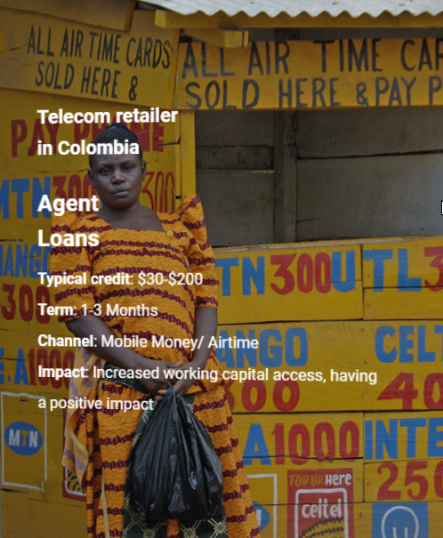
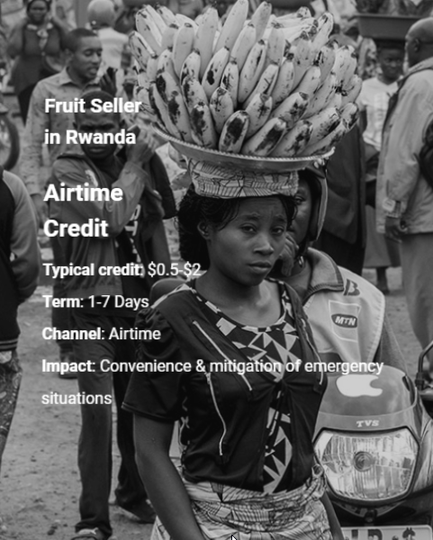
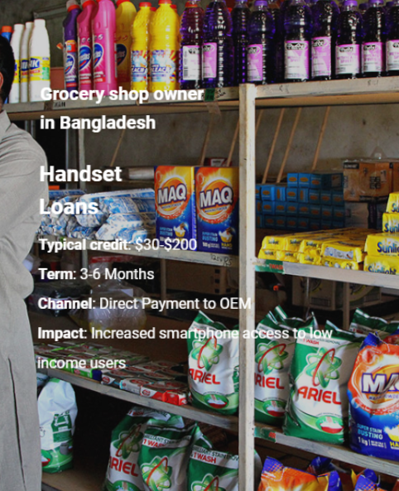
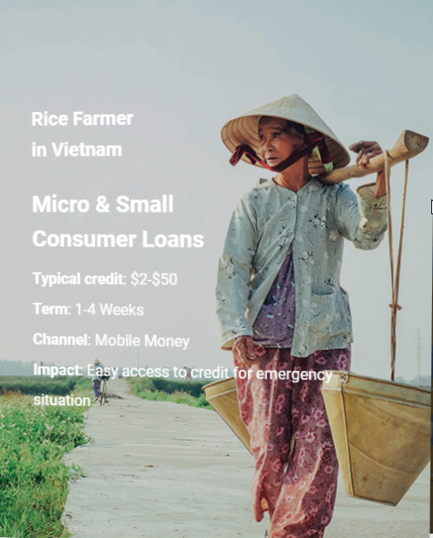
PRODUCTS

Slide 10
Conclusion
Big Data has contributed a lot to Finance industry and will keep on contributing with the expansion of block chains and cryptocurrencies
In the following years, Big Data will help financial services companies generate more revenue, maximize resources, and mitigate risk in trading, lending, investment, and banking
As of late 2018, just one-third of organizations have taken the move to implement using big data into their business processes
Consumer spending in India
According to World Economic Forum, growth expected from $1.5 trillion (present) to nearly $6 trillion by 2030
Massive opportunity for a fintech start-up’s to harness the increase in Big Data

Slide 11
References
Various articles at, https://www.yourstory.com/
Understanding various Use Cases explained at, https://www.h2o.ai/financial-services/
Understanding the business problem and technique for the solution at, https://www.yabx.co/
Understanding various Use Cases explained at, https://www.hdfstutorial.com/blog/big-data-use-cases-in-banking-and-financial-services/

Slide 12
Thank you

